Slide 1
DESIGN OF MULTIBIT PER CYCLE SUCCESIVE APPROXIMATION TYPE ADC
TEAM-4
BOBBALA VAISHNAVI :- 19K41A0494
JOOLURI ADITI :- 19K41A04A0
PARSHA SAI VINITH :- 19K41A04B0
KOYYADA AKHIL KUMAR:- 18K41A0485
UNDER THE GUIDENCE OF
MR.A.CHAKRADHAR(ASSistant .PROFESSOR,DEPT.OF ECE)

Slide 2
ABSTRACT
Our project presents an improved analog-to-digital converter (ADC) architecture based upon traditional successive approximation register (SAR) type ADC concepts.
The most important aspect of the present design is that it resolves two or more bits in a single cycle and hence requires much lesser time than a conventional SAR ADC for conversion of same resolution.
For example, for a 12-bit, successive approximation type ADC requires (N+1) clock cycles for an analog-to-digital conversion of resolution of N-bits; one clock cycle for sampling the input signal and N clock cycles for processing the successive-approximation algorithm generating N-bits, which would require thirteen clock cycles .
Where as multi bit per cycle successive approximation ADC requires only 4 clock cycles, it converts 3 bit per cycle to accomplish the conversion. Seven comparators are used in parallel to resolve 3 bits during each conversion cycle.
Divide and conquer algorithm is utilized here instead of the regular binary search algorithm employed for conventional SAR ADCs.

Slide 3
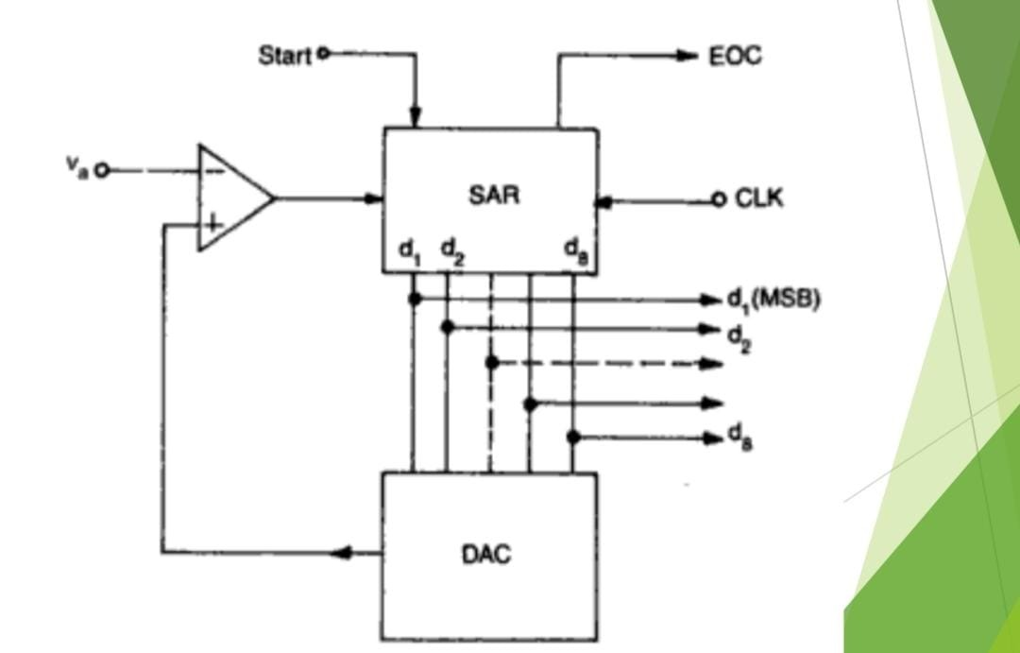
PROPOSED METHOD
The basic ideas of the design are based upon divide and conquer algorithm rather than binary search algorithm for regular successive approximation type ADCs.
In conventional designs the entire input range is sub-divided into two equal halves and comparison result with the mid-value selects one of them. This selected half is again sub-divided in two equal halves and one of them is again selected.
Thus proceeding in this way step-by-step, possible voltage range is narrowed down and finally a quantized level of desired resolution is achieved.
In the present improved design, the input is sub-divided into multiple zones (more than two) and the right range is selected by comparison at multiple levels.
Hence selected range of inputs after one step can be much smaller in this modified design than for conventional SAR ADCs. Repeating the same process, digital equivalent of the analog input can be obtained in much less number of steps for same resolution.

Slide 4
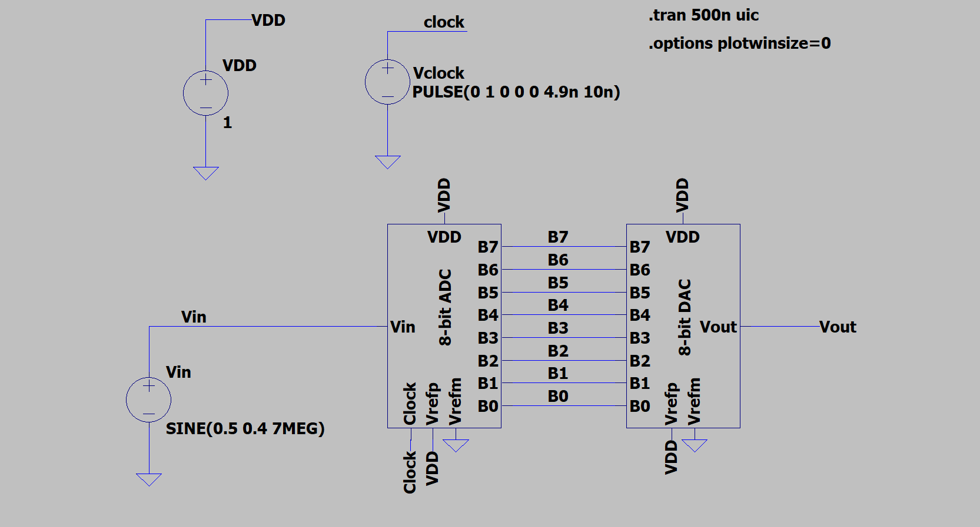
BLOCK DIAGRAM

Slide 5
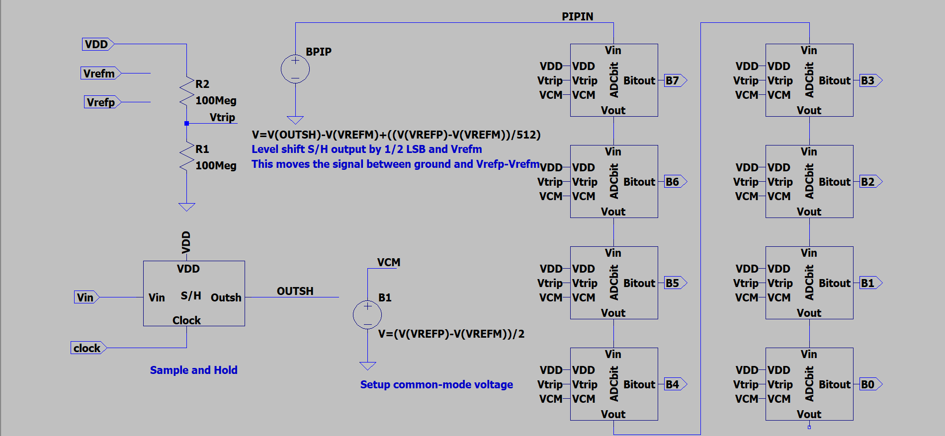
FIG.12.FULL ADC BLOCK DIAGRAM CONNECTIONS

Slide 6
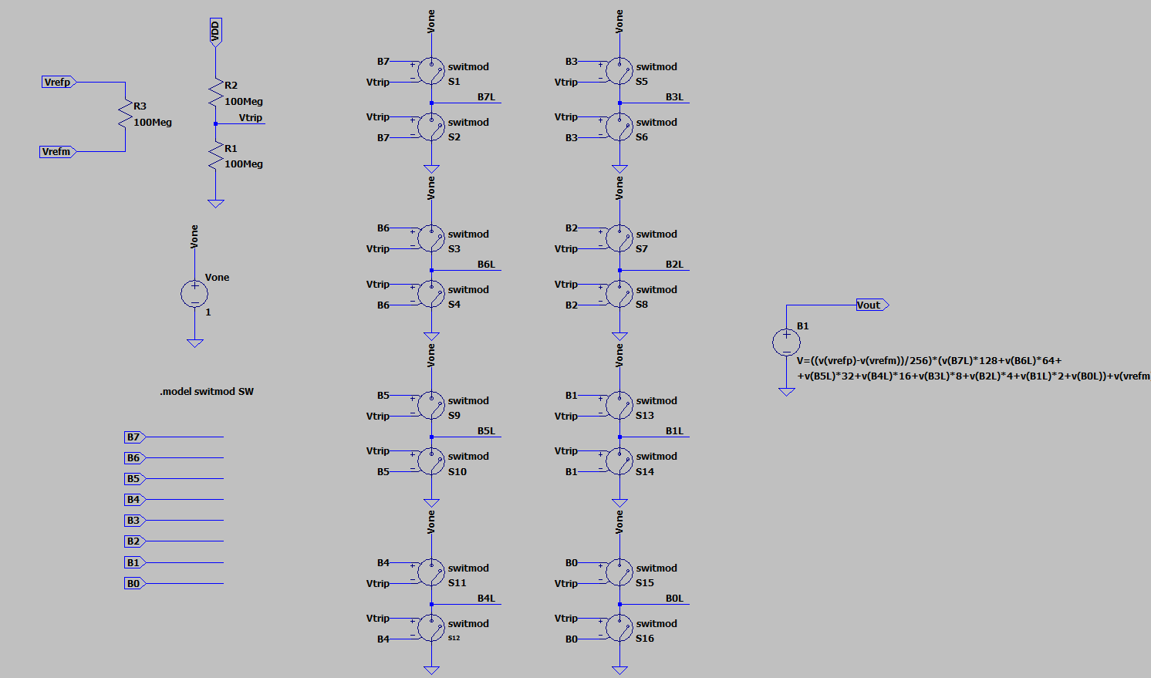
FIG.13.FULL DAC BLOCK DIAGRAM CONNECTIONS

Slide 7
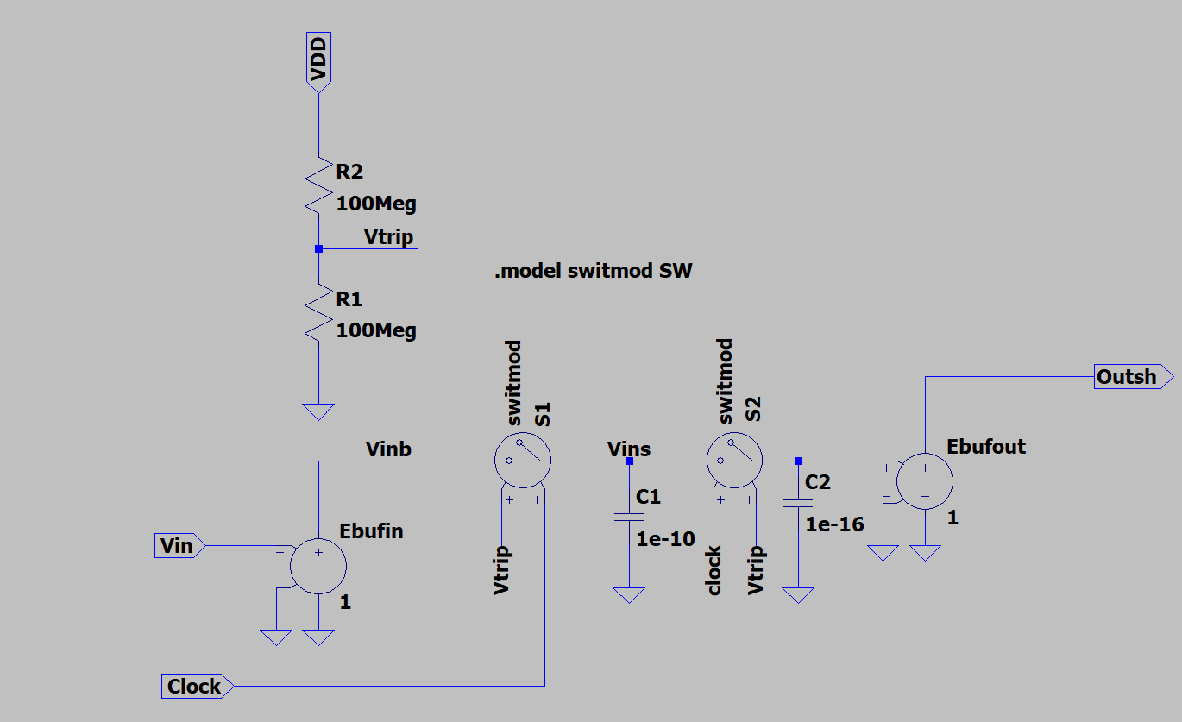
FIG.14.FULL SAMPLE AND HOLD CIRCUIT DIAGRAM

Slide 8
COMPONENTS
We have used software called LTSPICE.
The following are the components which we have used in our project :-
1.ADC converter
2.DAC converter
3.Sample and hold circuit
4.Operational amplifier
5.Voltage to current controller

Slide 9
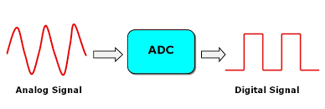
ADC CONVERTER
In electronics, an analog-to-digital converter (ADC, A/D, or A-to-D) is a system that converts an analog signal, such as a sound picked up by a microphone or light entering a digital camera, into a digital signal. An ADC may also provide an isolated measurement such as an electronic device that converts an analog input voltage or current to a digital number representing the magnitude of the voltage or current. Typically the digital output is a two's complement binary number that is proportional to the input, but there are other possibilities.
FIG:5.ADC CONVERTER

Slide 10
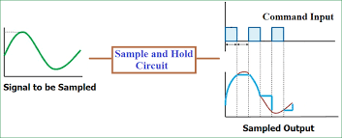
SAMPLE AND HOLD CIRCUIT
Sample & Hold Circuit is used to sample the given input signal and to hold the sampled value. Sample and hold circuit is used to sample an analog signal for a short interval of time in the range of 1 to 10µS and to hold on its last sampled value until the input signal is sampled again. The holding period may be from a few milliseconds to several seconds. The following figure shows the block diagram of a typical sample and hold amplifier.
FIG.6.SAMPLE AND HOLD CIRCUIT

Slide 11
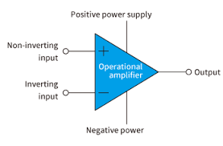
OPERATIONAL AMPLIFIER
An operational amplifier is an integrated circuit that can amplify weak electric signals. An operational amplifier has two input pins and one output pin. Its basic role is to amplify and output the voltage difference between the two input pins. An operational amplifier is not used alone but is designed to be connected to other circuits to perform a great variety of operations. The following figure shows the block diagram of an operational amplifier.
FIG.7.OPERATIONAL AMPLIFIER

Slide 12
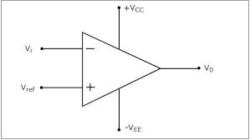
COMPARATOR
Comparators are devices that compare two voltages or currents and output a digital signal indicating which is larger. The output value of the comparator indicates which of the inputs is greater or lesser. A comparator compares the two inputs applied to it and produces the comparison as the output. It has two analog input terminals and one binary digital output. They are commonly used in devices that measure and digitize analog signals, such as successive-approximation ADCs and relaxation oscillators.
FIG.8.COMPARATOR

Slide 13
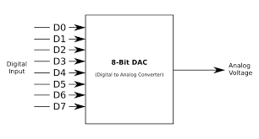
DAC CONVERTER
In electronics, a digital-to-analog converter is a system that converts a digital signal into an analog signal. An analog-to-digital converter (ADC) performs the reverse function . There are several DAC architectures, the suitability of a DAC for a particular application is determined by figures of merit including: resolution, maximum sampling frequency and others. Digital-to-analog conversion can degrade a signal, so a DAC should be specified that has insignificant errors in terms of the application.
FIG.9.DAC

Slide 14
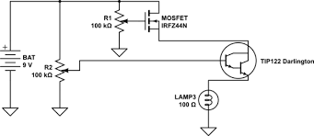
VOLTAGE TO CURRENT CONTROLLER
Stable voltage sources are common and widely available, whereas it takes some effort to create anything approaching the ideal current sources that appear in theoretical circuit diagrams. Consequently, the current flowing through a load is generally determined by the amplitude of the applied voltage and the load’s current–voltage characteristics. In the case of an ordinary resistive load, the current–voltage relationship is simply the resistance. Thus, current equals voltage divided by resistance. If the load resistance changes, the load current changes proportionally.
FIG.11 VOLTAGE TO CURRENT CONTROLLER

Slide 15
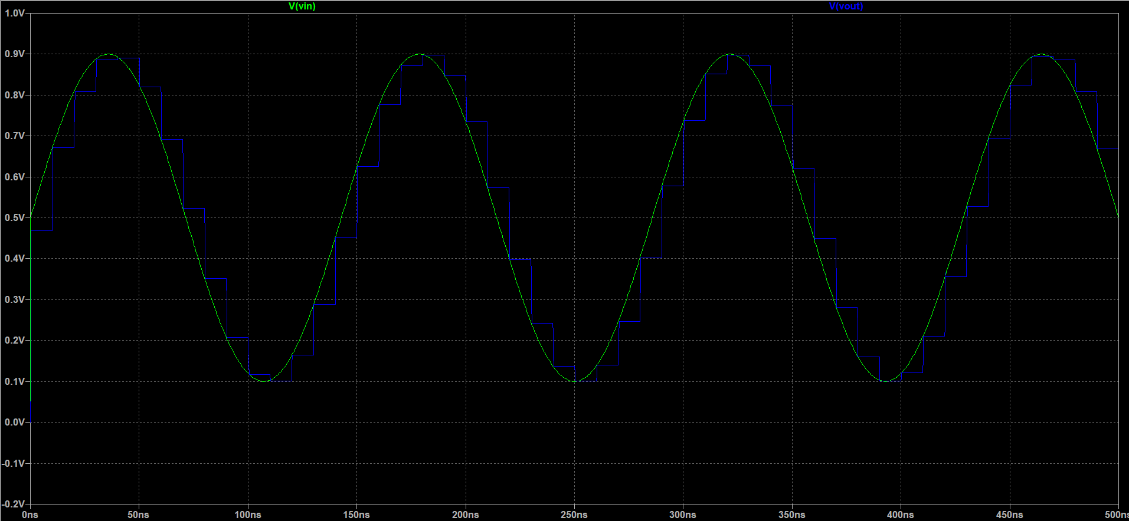
SIMULATION RESULTS AND ANALYSIS
FIG.15.SIMULATION RESULT FOR A SINUSOIDAL INPUT AND SQUARE OUTPUT SIGNAL

Slide 16
CONCLUSION
In this project, a multi-bit-per-cycle successive approximation type ADC is presented.
A 12-bit 3-bit-per-cycle ADC was simulated in LTSPICE which requires only 4 clock cycles to achieve a resolution of 12 bits.
The presented ADC architecture is 3.25 times faster than a conventional SAR ADC by using seven comparators in parallel.
The circuit, operated with a clock frequency of 8 MHz, achieves an effective sampling frequency of 2 MHz .
Simulation results confirm the validity of the proposition.

Slide 17
FUTURE SCOPE
Further, we can try this project in other platforms such as MATLAB SIMULINK and also do the project using hardware components.

Slide 18
THANK YOU

